Slide 1
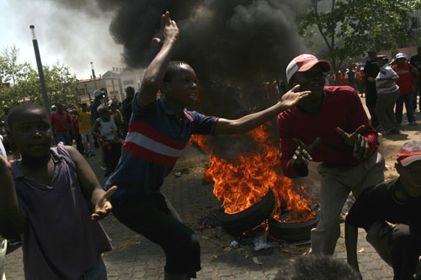
“Khutsong is only a drop in the ocean”: provincial boundary dispute in post apartheid South Africa
By Mazembo Mavungu Eddy
Phd Candidate
Political studies / University of the Witwatersrand
Johannesburg/ South Africa

Slide 2
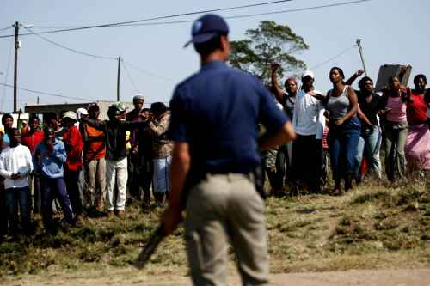
“Khutsong is only a drop in the ocean”: provincial boundary dispute in post apartheid South Africa

Slide 3
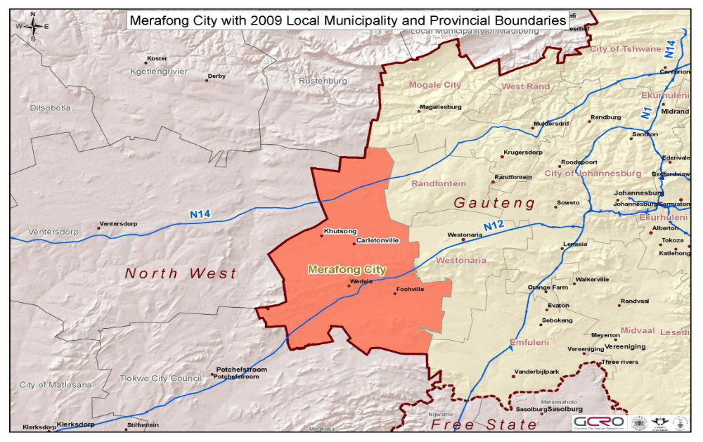
“Khutsong is only a drop in the ocean”: provincial boundary dispute in post apartheid South Africa

Slide 4
“Khutsong is only a drop in the ocean”: provincial boundary dispute in post apartheid South Africa
Timeline of events in the border dispute
December 2005: the legislation moving Merafong to North West is passed and signed into law. Protest intensifies in Khutsong
March 2006: Local elections boycott in Khutsong and riots
April 2007: disruption of schooling in Khutsong
December 2007: Polokwane conference where Zuma ascends to ANC presidency
13 June 2008: The Constitutional Court dismisses Khutsong’s application
September 2008: President Mbeki recall, resignation of Mufumadi and Mbazima Shilowa ( architects of the contested policy)
March 2009: Merafong is reincorporated back in Gauteng

Slide 5
“Khutsong is only a drop in the ocean”: provincial boundary dispute in post apartheid South Africa
Explanatory framework
How to explain provincial boundary disputes?
Material conditions
Local notions of democracy and development
Conflicting regional planning models
Government’s democratic deficit
Strategic political struggles
Limits of judicial arbitration

Slide 6
“Khutsong is only a drop in the ocean”: provincial boundary dispute in post apartheid South Africa
Background facts
Merafong, a sotho name for “place of gold” and Khutsong is a tswana name meaning “place of peace”
Merafong:
population (215 865); 52% of employed people, 20.6% of unemployed and 26.7% of economically inactive
Khutsong:
Has 32% of the municipality’s population
26.4% of employed,
35% of unemployed and 39.6 of economically inactive (Ricon (Pty) Ltd –Regional explorer data base. 2001).
Some 70.6% of Khutsong’s inhabitants are classified as having no income.
Before 2006 : cross boundary municipality
71% of the population belonged to Gauteng
29% of the population belonged to North West

Slide 7
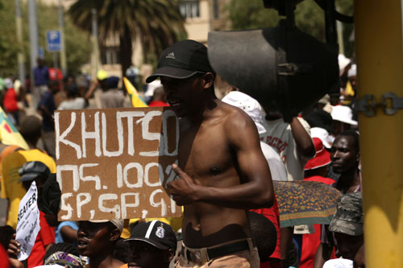
“Khutsong is only a drop in the ocean”: provincial boundary dispute in post apartheid South Africa

Slide 8
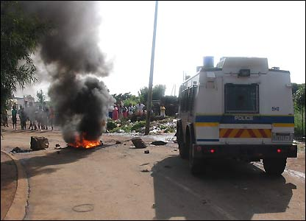
“Khutsong is only a drop in the ocean”: provincial boundary dispute in post apartheid South Africa

Slide 9
Thank you
Questions and comments are
welcome
Eddy Mazembo Mavungu
PhD candidate
Political Studies
University of the Witwatersrand
mazembo.mavungu@students.wits.ac.za

